Slide 1
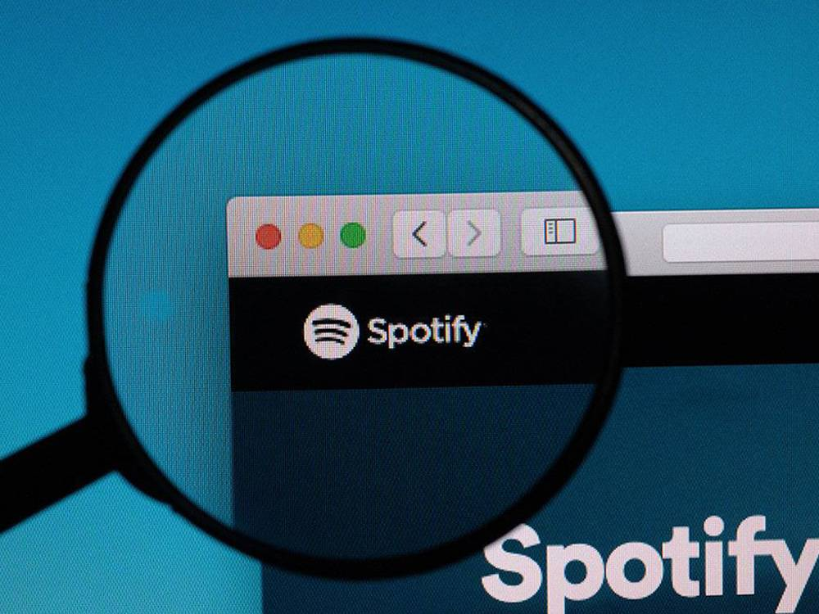
Motivation & Research Questions
Explore some of the data points that enables Spotify to generate and curate their most Popular Playlists.
Analyze Spotify’s publicly available Playlists and Songs across different Genres of music to understand the different Audio Features and determine relationships and trends driving their Popularity.
Which Genres are more popular than others? Statistically, are there significant differences in Popularity between Genres?
How do various Audio Features of a Song - such as it's Danceability and Energy - influence it’s Popularity?
How are popular songs trending in terms of their Valence, i.e. songs that sound more positive (e.g. happy, cheerful, euphoric), vs songs that sound more negative (e.g. sad, depressed, angry)? Is there any correlation between the Speechiness and the Valence of a song?
Does the Duration of a song affect it’s Position within a playlist?
Does the Position of a song in a playlist impact it’s Popularity?
Are Singles more popular than full-length Albums or Compilations?

Slide 2
Data Exploration & Cleanup
Create Spotify App Integration
Encode API Credentials
Obtain Spotify Access Token
Retrieve Tracks within each Playlist using Spotify’s web API
Store & Merge to a clean DataFrame for Analysis
Identify 5 Popular Spotify Playlists across 12 Genres
Retrieve Audio Features of each Track using Spotify’s Web API
Multi-step, complex authentication flow to retrieve web API data that involves:
Spotify authorizing your Python app to access their Platform (APIs)
Spotify granting your Python app permission to access their curated playlists
Relatively clean dataset with minimal massaging required
Only sourced publicly available Playlists (created/curated by Spotify)
Limited data collection to Audio tracks
Found and resolved exceptions for Video tracks
Finding a needle in the haystack = heavy debugging
1 out of 4000+ sampled songs did not have any audio feature data
Variety > Quantity
Helped prevent API Rate Limit issues
Not required to refresh Access Token every hour
Track Position/Rank
Track Name
Popularity Score
Duration
Added At Date/Time
Album & Album Type
Artists
Release Date
Available Markets
Key
Mode
Time Signature
Acousticness
Danceability
Energy
Instrumentalness
Liveness
Loudness
Speechiness
Valence
Tempo

Slide 3
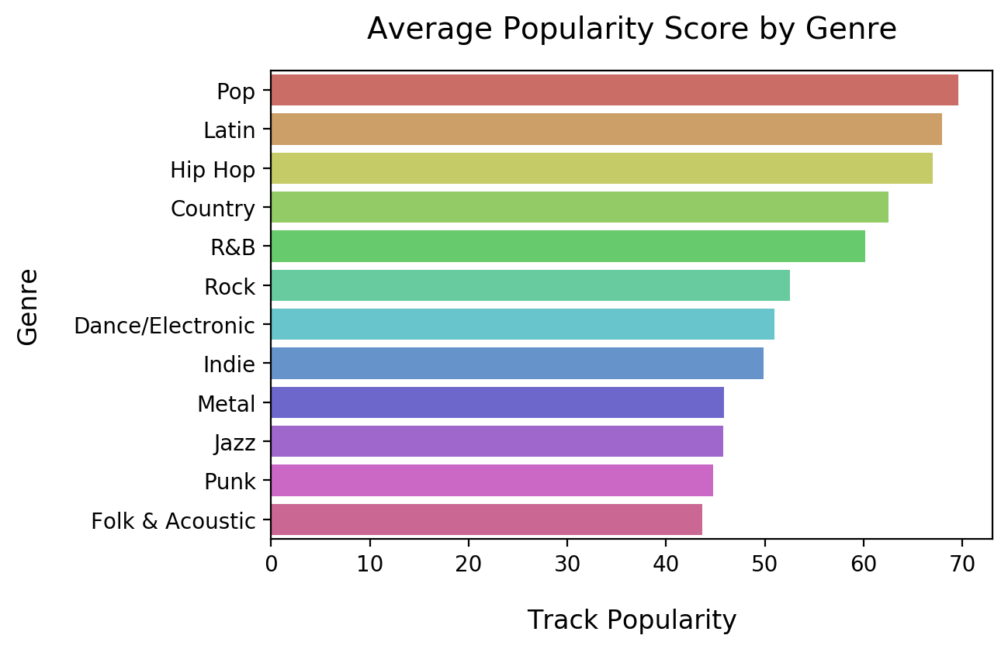
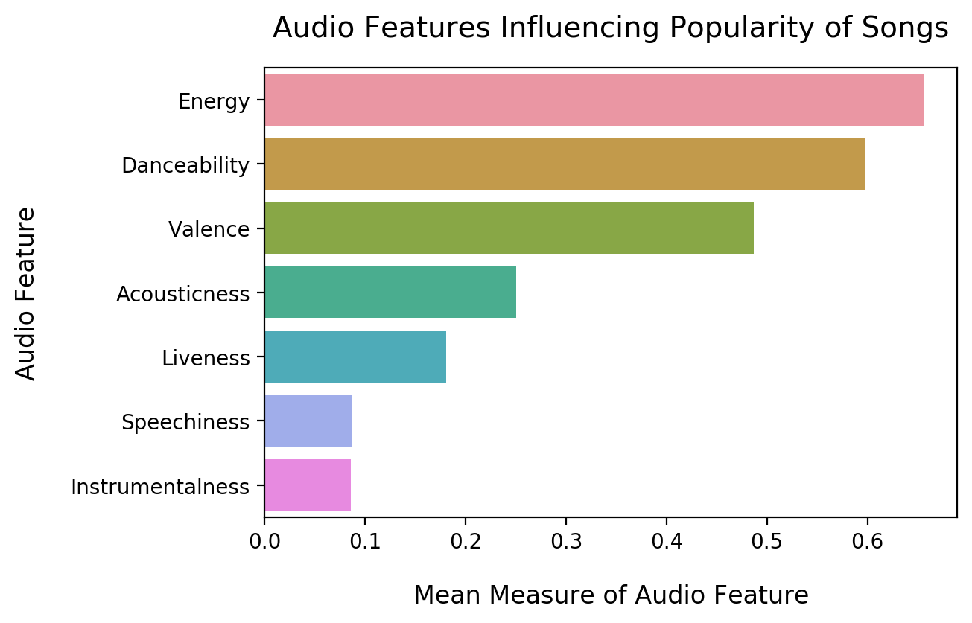
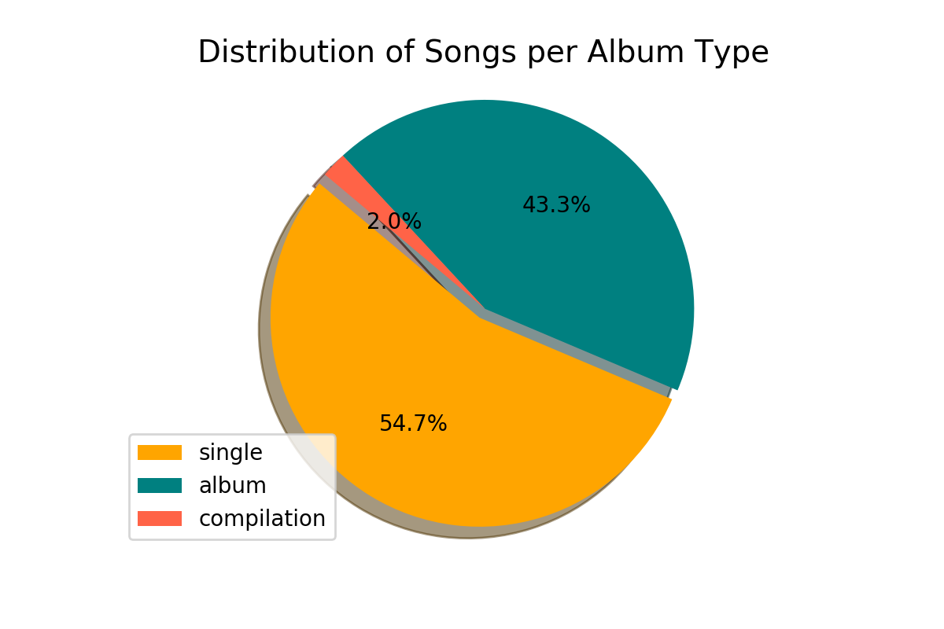
Summary Stats
The popularity of a track is a value between 0 and 100, with 100 being the most popular. Popularity is calculated by Spotify using an algorithm and is based, in the most part, on the total number of plays the track has had and how recent those plays are. Generally speaking, songs that are being played a lot now will have a higher popularity than songs that were played a lot in the past.
4427 Songs
12 Genres
9 Audio Features Per Track

Slide 4
Audio Features Overview
Instrumentalness: This value represents the amount of vocals in the song. The closer it is to 1.0, the more instrumental the song is.
Acousticness: This value describes how acoustic a song is. A score of 1.0 means the song is most likely to be an acoustic one.
Liveness: This value describes the probability that the song was recorded with a live audience. According to the official documentation “a value above 0.8 provides strong likelihood that the track is live”.
Speechiness: “Speechiness detects the presence of spoken words in a track”. If the speechiness of a song is above 0.66, it is probably made of spoken words, a score between 0.33 and 0.66 is a song that may contain both music and words, and a score below 0.33 means the song does not have any speech.
Energy: “(energy) represents a perceptual measure of intensity and activity. Typically, energetic tracks feel fast, loud, and noisy”.
Danceability: “Danceability describes how suitable a track is for dancing based on a combination of musical elements including tempo, rhythm stability, beat strength, and overall regularity. A value of 0.0 is least danceable and 1.0 is most danceable”.
Valence: “A measure from 0.0 to 1.0 describing the musical positiveness conveyed by a track. Tracks with high valence sound more positive (e.g. happy, cheerful, euphoric), while tracks with low valence sound more negative (e.g. sad, depressed, angry)”.

